Slide 1
Predicting test scores using machine learning
5-E-4 Satoru Kato
Notes:
This time I used machine learning to predict test scores.

Slide 2
・purpose
Case1:
Case2:
In large-scale tests such as national mock exams,
it is important to know your test score at the end of
the test, but this takes a lot of time.
Studying is extremely difficult, and we want to avoid failing in the shortest possible time.
Predict test scores from data
Notes:
There are two reasons why we used machine learning.
First, for large-scale tests like national mock exams, it's important to know your test score at the end of the test. However, this takes time.
Second, studying is extremely difficult, and if possible, you want to avoid failing in the shortest possible time.
↓
For these reasons, we need to predict test scores.
機械学習を行った理由は二つある。
一つ目の理由として、全国模試などの大きい規模のテストではテスト終わりに自分のテストの点数を把握することが大切。しかしそれには時間がかかる。
二つ目の理由として、勉強はめっちゃ大変、できれば最低の時間で赤点を回避したい。
↓
これらの理由からテストの点数を予測する必要がある

Slide 3
Dataset used
→Timothy Adeyemi ‘ S Student Performance
link：https://www.kaggle.com/datasets/timothyadeyemi/student-performance
→This dataset contains information on study time, attendance, and other aspects that affect academic performance.
Data used this time:
Notes:
The dataset used here is Timothy Adeyemi's Student Performance dataset. This dataset includes information that affects grades, such as study time and attendance.
Among these data, we will use the data for Hours_Studied, Attendance,Motivation_Level, and Sleep_Hours to make predictions.

Slide 4
Used algorithm
〇linear regression
・An analytical method used to predict the value of one variable from the value of another variable
〇Lasso regression
・This is a learning method that adds an L1 regularization term (the sum of the absolute values ​​of the regression coefficients) to a linear regression model. By forcibly setting the coefficients of explanatory variables with low importance to zero, unnecessary features are automatically deleted, simplifying the model and preventing overfitting.
〇Ridge regression
・Ridge regression is a method that suppresses overfitting by adding L2 regularization to a linear regression model.
〇 hoover regression
・A type of robust regression
→A learning method that minimizes the impact of outliers when the training data contains them.
・Regression is performed by adding a Huber function to the loss.
Notes:
The algorithm used is as follows:
・Linear regretrion is an analytical method used to predict the value of one variable based on the value of another variable.。
・Lasso regretion is a training method that adds an L1 regularization term (the sum of the absolute values ​​of the regression coefficients) to a linear regression model. By forcibly setting the coefficients of unimportant explanatory variables to zero, unnecessary features are automatically removed, simplifying the model and preventing overfitting.
・Ridge regression is a method that suppresses overfitting by adding L2 regularization to a linear regression model.
・Hoober regret is a type of robust regression.
Adding a Hoober function to the loss for regression.

Slide 5
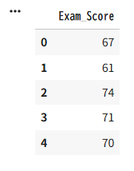
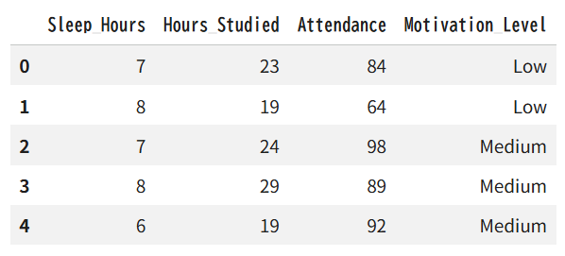
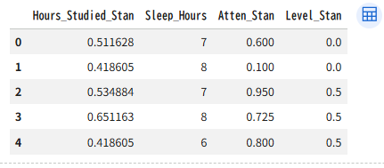
Element
X element
Y element
X element(standard)
Notes:
The elements are shown in this diagram.
After standardization, the table will look like this
要素はこの図になります。
標準化を行ったらこの表になります

Slide 6
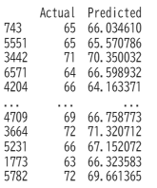
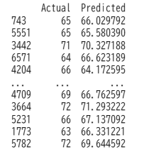
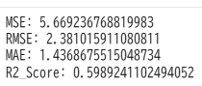
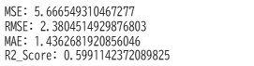
result
・Linear regression
・Lasso regression
Actual and Predictions
Actual and Predictions
Notes:
The results of linear regression and lasso regression are shown in the graph below.
The results of lasso regression seem to have a bit more error.
線形回帰、ラッソ回帰を行った結果、このような図になっています。
ラッソ回帰では結果から少し誤差が多いように思える。

Slide 7
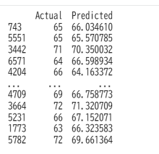
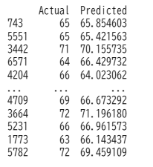
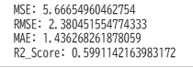
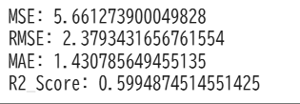
result
・Ridge regression
・Huber regression
Actual and Predictions
Actual and predictions
Notes:
The results of Ridge regression and Huber regression are shown in the graph below.
It seems that Huber regression has less error in the results.
When compared to the previous results, the results are similar and not much has changed.
リッジ回帰、フーバー回帰を行った結果、このような図になっています。
フーバー回帰のほうが結果から誤差が少ないように思える。
先ほどの結果と比較すると同じような結
果となり、変化があまり見られなかった。

Slide 8
Summary
・This time, analysis was performed using four analysis methods.
・The results showed little error and a good R2 score. Therefore, it is thought that scores can be estimated to a certain extent from the data.
・Unsupervised learning was performed using all four methods, but no changes were observed, so other methods will need to be considered.
Notes:
Summary
・This time, analysis was performed using four analysis methods.
・The results showed little error and a good R2 score. Therefore, it is thought that scores can be estimated to a certain extent from the data.
・Unsupervised learning was performed using all four methods, but no changes were observed, so other methods will need to be considered.

Slide 9
Thank you for listening to my speech

Slide 10
タイトル
→テストの点数を機械学習から予測
5-E-4 Satoru Kato
Notes:
テストの点数を機械学習で予測を行いました

Slide 11
・書く内容
タイトル
どういうことをやったん
データの結果
まとめ

Slide 12
使用したデータセット
Timothy AdeyemiのStudent Performance
リンク：https://www.kaggle.com/datasets/timothyadeyemi/student-performance
→このデータセットには勉強時間、出席状況など学業成績に影響を与える側面に関する情報が含まれています
今回用いるデータ：
Notes:
今回使用したデータセットはTimothy AdeyemiのStudent Performanceというデータセットです
このデータセットには勉強時間、出席数などの成績に影響を与える情報を含みます
そのデータの中でも今回はHours_Studied, Attendance, Sleep_Hoursのデータを用いて予測を行う

Slide 13
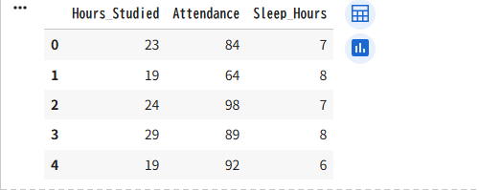
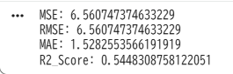
データの結果（Hours_Studied, Attendance, Sleep_Hours）
X element
Y element
evaluation
Notes:
A multiple regression analysis was performed using Hours_Studied, Attendance, and Sleep_Hours, and the R2_score was 0.544, so it is thought that the factors used have a slight effect on the grades.

Slide 14
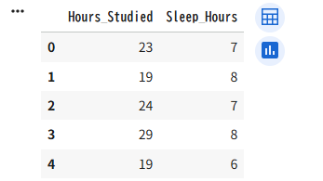
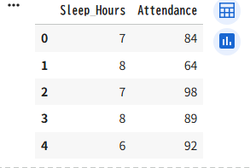
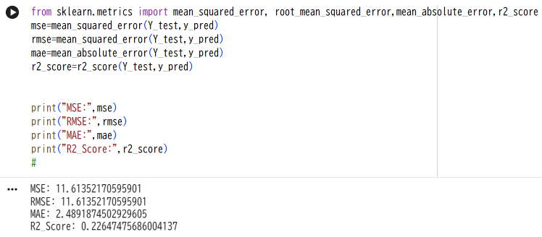
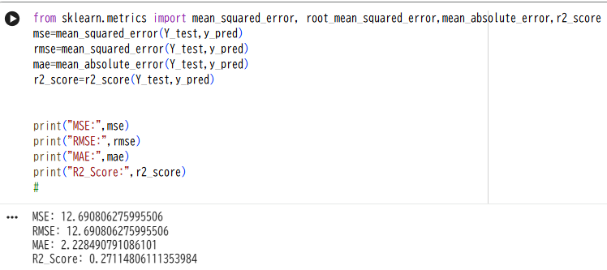
データの結果（Hours_Studied, Sleep_Hours）
データの結果（Attendance, Sleep_Hours）
X element
X element
evaluation
evaluation
Notes:
When machine learning was performed on these combinations of data, the R2_score was low for both. Therefore, it can be seen that these combinations are not suitable.

Slide 15
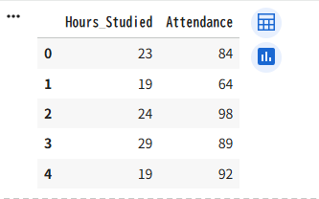
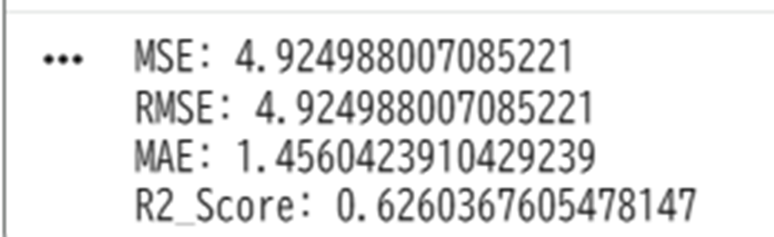
データの結果（Hours_Studied, Attendance）
X element
evaluation
Notes:
When machine learning was performed using the combination of Hours_Studied and Attendance, the R2_score was 60%. Therefore, it is considered to be quite suitable for predicting grades.

Slide 16
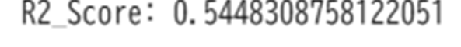
summary
Attribute
evaluation
・Hours_Studied
・Sleep_Hours
・Attendance
・Sleep_Hours
・Hours_Studied
・Attendance
・Sleep_Hours
・Hours_Studied
・Attendance
Notes:
Bad combinations like the ones in the red box have low scores, so you can see that they are not good inputs.
The results in the blue box show that the test results show that Hours_Studied and Attendance have a significant impact on accuracy.
赤枠のようなよくない組み合わせではスコアが低いため、いい入力ではないことがわかる
青枠の結果からテスト成績は、・Hours_Studied、・Attendanceが精度に大きく影響を与えることがわった。

Slide 17
使用するアルゴリズム
〇linear regression
・ある変数の値を別の変数の値から予測するために使用される分析方法
〇Lasso regression
・線形回帰モデルにL1正則化項（回帰係数の絶対値の和）を加えて学習する手法です。重要度の低い説明変数の係数を強制的にゼロにすることで、不要な特徴量を自動的に削除し、モデルをシンプルにして過学習を抑制する
〇Ridge regression
・リッジ回帰は、線形回帰モデルにL2正則化を追加することで、過学習を抑制する手法
〇 hoover regression
・ロバスト回帰の一種
→訓練するデータに外れ値が含まれているときに、その外れ値の影響をできるだけ少なくするような学習方法
・損失にフーバー関数を追加して回帰を行う。
Notes:
The algorithm used is as follows:
・Linear regretrion is an analytical method used to predict the value of one variable based on the value of another variable.。
・Lasso regretion is a training method that adds an L1 regularization term (the sum of the absolute values ​​of the regression coefficients) to a linear regression model. By forcibly setting the coefficients of unimportant explanatory variables to zero, unnecessary features are automatically removed, simplifying the model and preventing overfitting.
・Ridge regression is a method that suppresses overfitting by adding L2 regularization to a linear regression model.
・Hoober regret is a type of robust regression.
Adding a Hoober function to the loss for regression.

Slide 18
まとめ
・今回は四つの解析手法で解析を行った。
・結果から誤差が少なく、R2scoreもよい結果が見られた。そのため、データからある程度、点数の推測ができると考えられる。
・四つの手法で教師なし学習を行ったが、変化が見られなかったので他の他の手法を扱う必要がある。
Notes:
まとめです。
今回は四つの解析手法で解析を行った。
結果から誤差が少なく、R2scoreもよい結果が見られた。
そのため、データからある程度、点数の推測ができると考えられる。
・四つの手法で教師なし学習を行ったが、変化が見られなかったので他の他の手法を扱う必要がある。

